Slide 1
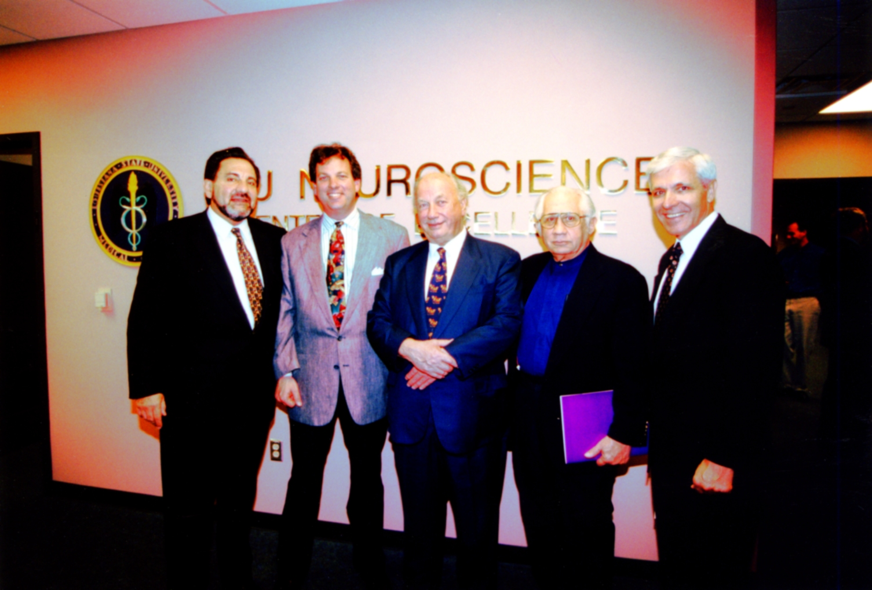
Dr. Nicolas G. Bazan, Joseph Grace, Sir John Vane, Dr. Robert Paddison, Brother Gale Conduit

Slide 2
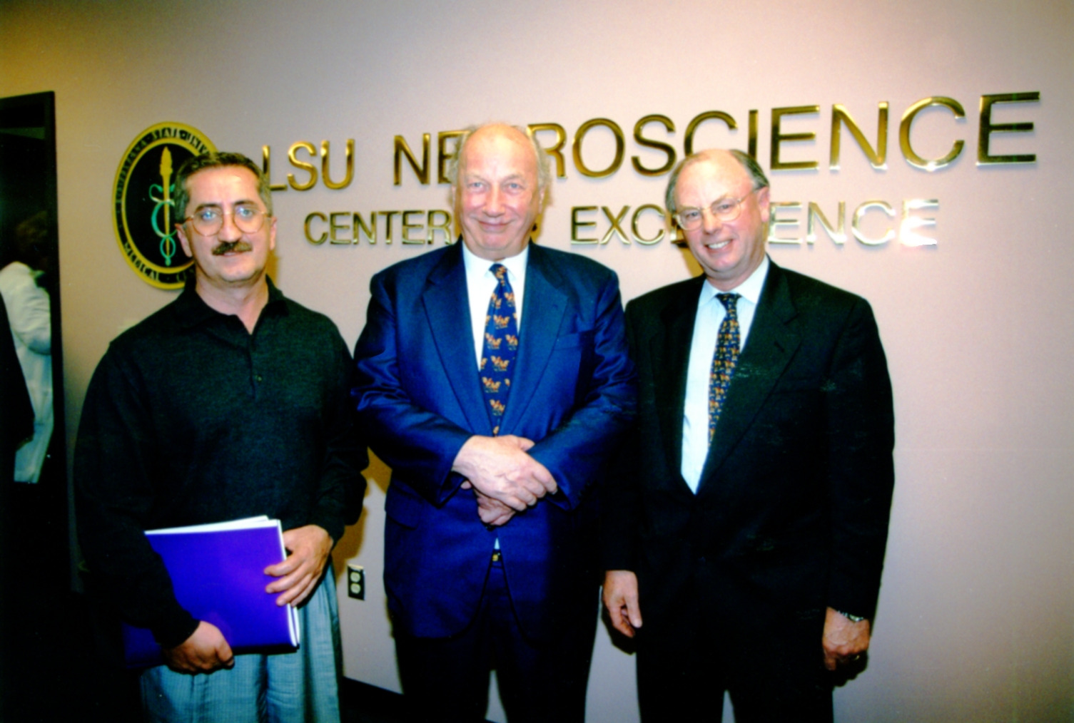
Dr. Reha Erzurumlu, Sir John Vane, Dr. Austin Sumner

Slide 3
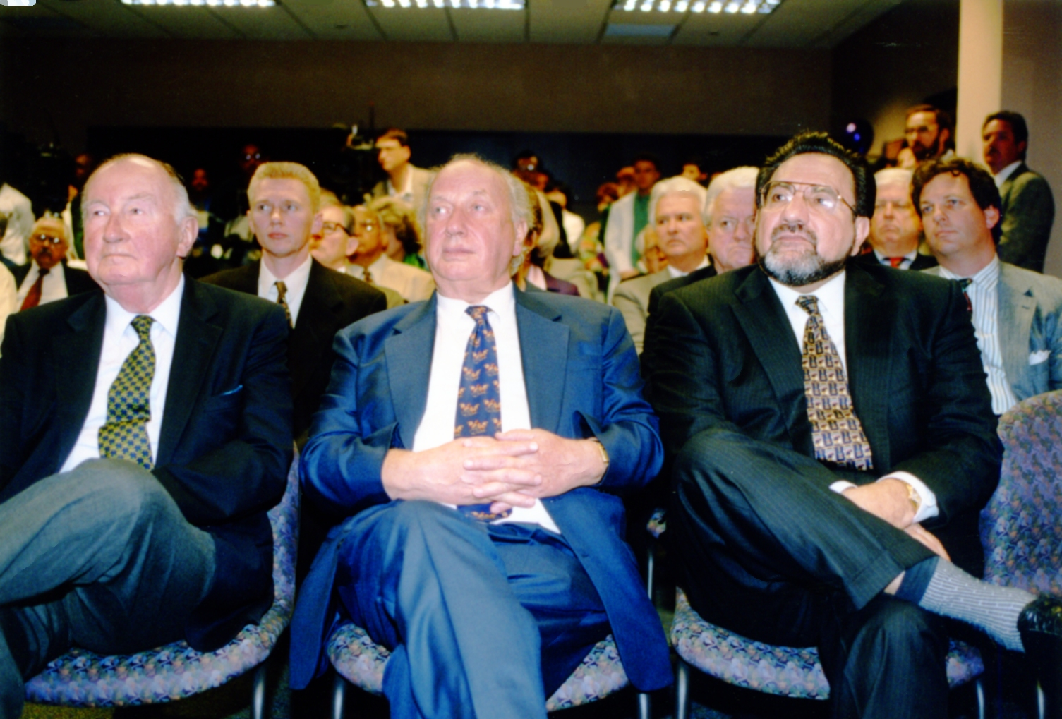
Gentleman with Sir John Vane and Dr. Nicolas G. Bazan

Slide 4
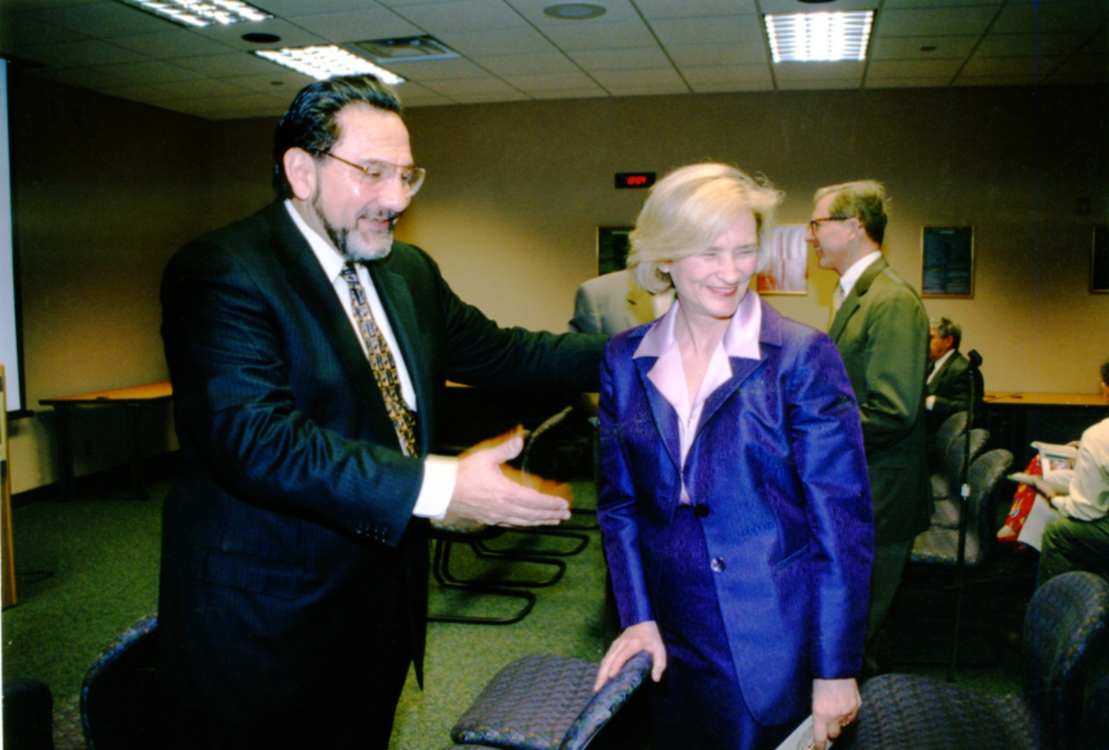
Dr. Nicolas G. Bazan and Mrs. Margie Villere

Slide 5
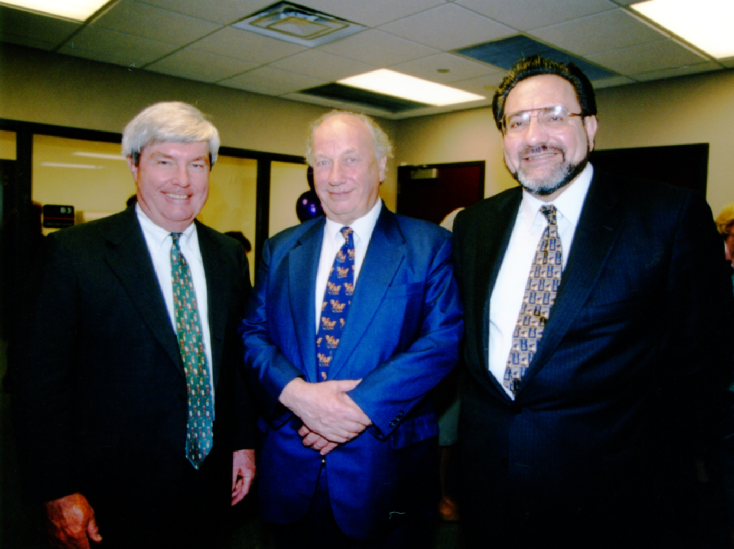
Mr. William Finegan and Sir John Vane with Dr. Nicolas G. Bazan

Slide 6
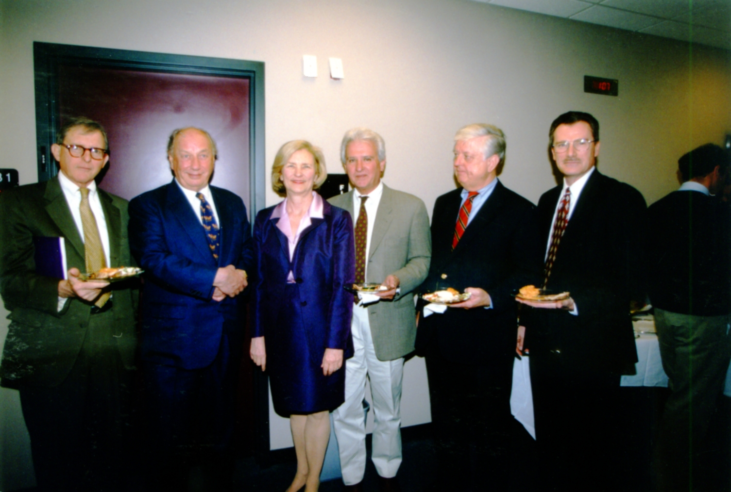
St. Dennis Villere, Sir John Vane, Mrs. Margie Villere,
Pio Lyons, Bert Wallace, Dr. Kenneth Narducy

Slide 7
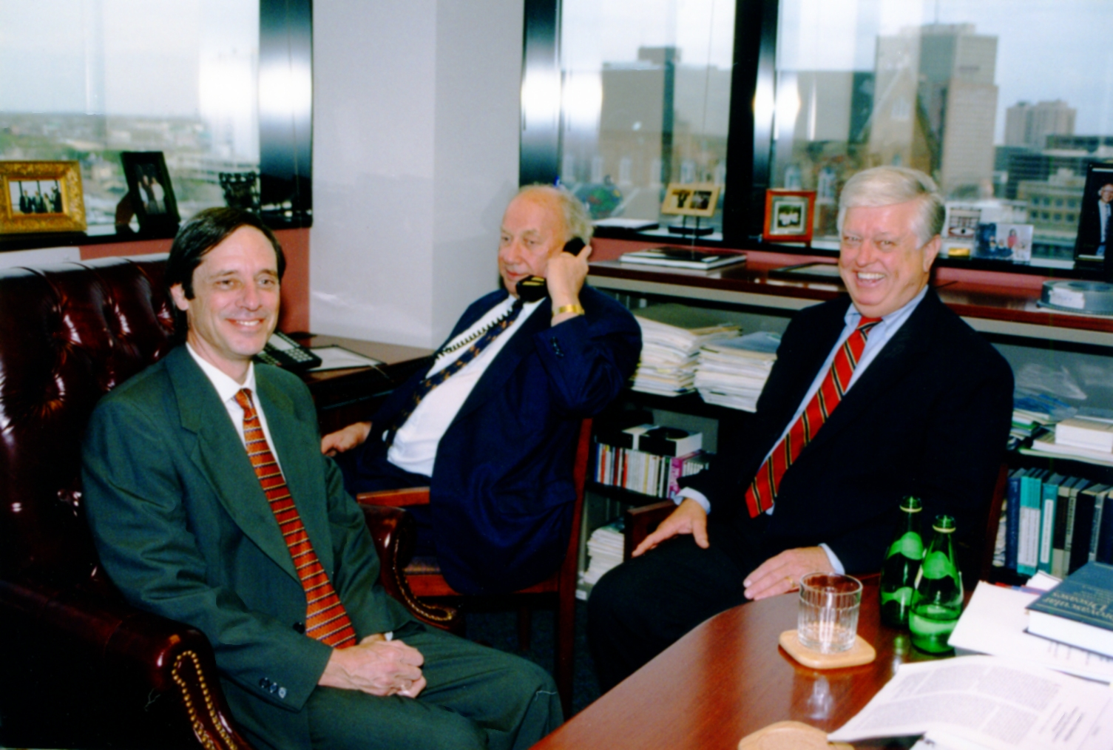
Ellis Johann Bultman, Sir John Vane and Bert Wallace

Slide 8
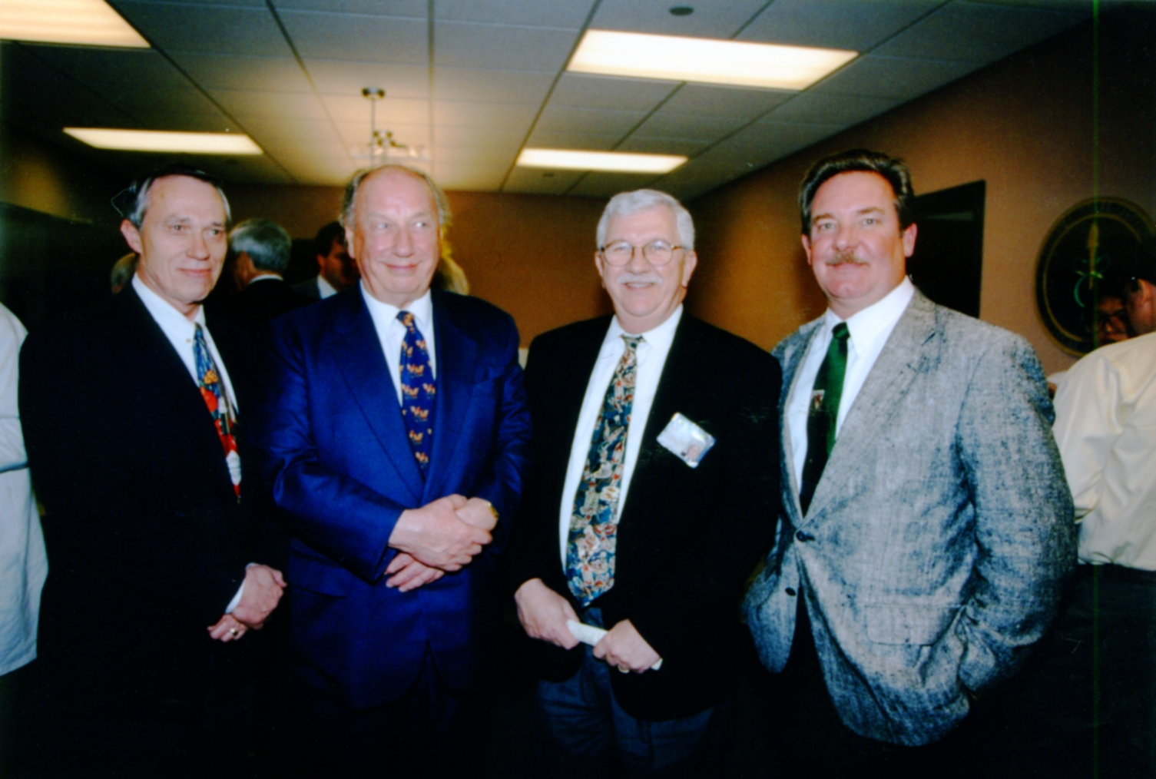
Dr. Larry Carver, Sir John Vane, Dr. John Ruby, Dr. Kenneth Kratz

Slide 9
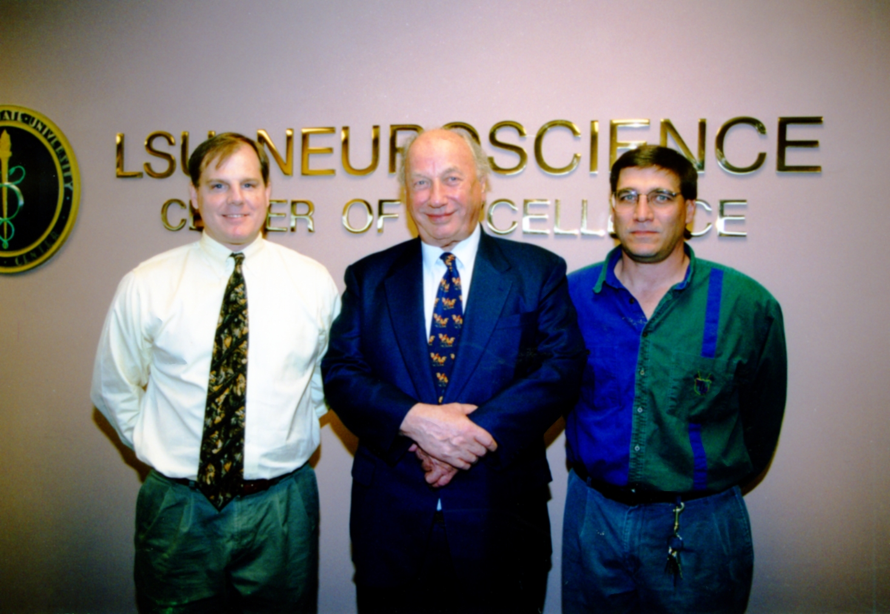
Dr. Dennis Paul, Sir John Vane and Dr. William Guido

